Slide 1
Connected Vehicle Deployment –
DfT perspective
Graham Hanson
Department for Transport

Slide 2
Connected Vehicles and Deployment – what are the Department’s role?
Centre for Connected and Autonomous Vehicles –
  UK world-leading connected and autonomous vehicles (CAV) industry
  UK environment to develop and use connected and autonomous vehicles
  Lead national CAV research
  CAVs safe and secure by design
Traffic and Technology Division?
  Use of technology to improve traffic management/manage congestion
  Deployment and innovation
  Enhancing UK’s role as leader in traffic management and connected technologies
  Monitoring and evaluation
  Guidance
  Foster partnership/collaborative working

Slide 3
What do we expect from today
Focus on deployment – not the technologies
Understand current deployment and use cases
Align pilots across themes
Monitor, evaluate and create business cases
Common Evaluation Framework
Exchange lessons learned
Build a community
Consider next steps

Slide 4
A traffic network with limited connectivity
.
Network manager
Controls the network, trying to reduce traffic and emissions
Services
Also known as Intelligent Transport, these services allow the network manager to achieve his aims
Roadside infrastructure
Provides visual signals to the driver and can send messages back to the services.
Driver
Messages are broad direct to the driver through sight and sound
Pothole information gathered through local reports and knowledge
Gritting and weather control provided through historic trends.
Updates to the car come from buying a new model

Slide 5
A world with connectivity
In practice the connected vehicle will communicate to many different sources and this diagram shows some of the different services which can be provided from this added level of communication.
!
Connected Vehicle
Information on the network e.g. potholes and other valuable information such as weather patterns
Safety messages and other communications
Network manager
Controls the flow of traffic to minimise traffic and emissions
Connected Vehicle
All communicated direct to the car
Apps
Provide infotainment services and information on the road network
Satellite Navigation Systems
Services
The systems the network manager uses to achieve their aims
Communication Infrastructure
Provides instructions, such as road works information
The Cloud
Provides updates to the car on systems and connects it to the Internet of Things
Mobile phones

Slide 6
But is connected all about the national road network?
  Cooperative ITS – defined as “C-ITS are systems that allow effective data exchange through wireless technologies so that vehicles can connect with each other, with the road infrastructure and with other road users.”
  Current trials limited to motorways and inter-urban roads (with exceptions)
  Day1 services defined as: Hazardous location notifications: Slow or stationary vehicle(s) & Traffic ahead warning; Road works warning; Weather conditions Emergency brake light Emergency vehicle approaching Other hazardous notifications Signage applications: In-vehicle signing; Signal violation/Intersection Safety; Traffic signal priority request by designated vehicles; Green Light Optimal Speed Advisory (GLOSA); Probe vehicle data; Shockwave Damping

Slide 7
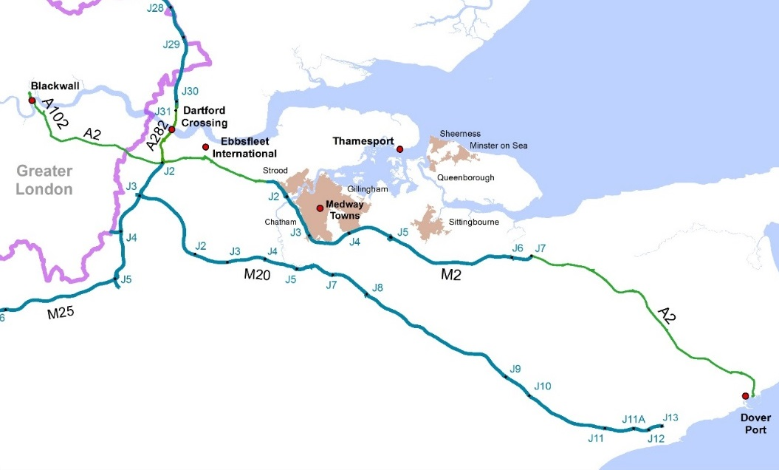




A2/M2 Connected Vehicle Corridor

Slide 8
Intercor – connecting Corridors

Slide 9
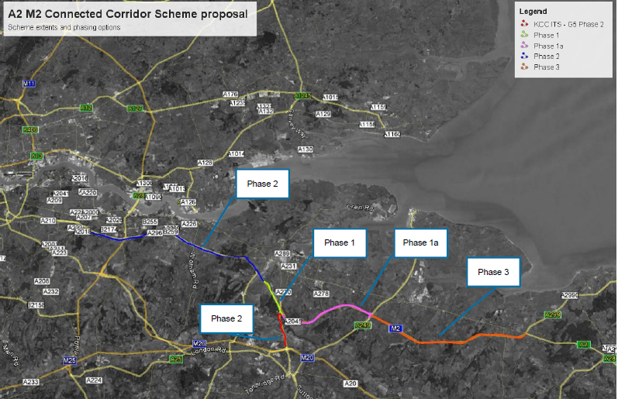
A2/M2 Connected Corridor

Slide 10
“ Day One” services
Service | Use Case: Communications Implementation
Floating Car Data | ITSG5 and cellular services at a minimum
Green Light Optimisation, speed assistance
In Vehicle Signage
Road Works Warning

Slide 11
What does C-ITS mean for local authorities?
  Claimed potential benefits include improved flow, safety, emissions etc
    But not much is yet proven
  Communication technology – the choice has strong impact on
    Technical effectiveness for specific services
    Cost of deployment
    Cost of operation
  Before implementing a local authority will need to consider:
    Who receives benefit
    How widespread benefit is
    How benefit is valued
    How robust the benefit estimate is

Slide 12
DfT C-ITS competition
Awarded C-ITS schemes for 19 English local authorities incl.:
Freight C-ITS in West Midlands (GLOSA)
C-ITS freight services, Hinckley Point (Somerset)
Innovative smart traffic management in York
C-ITS platform in Portsmouth
Real-time connected traffic management solutions – Derbyshire, Dorset, Swindon and many others
Range of smart parking solutions
Peterborough Council – innovation to support vulnerable road users

Slide 13
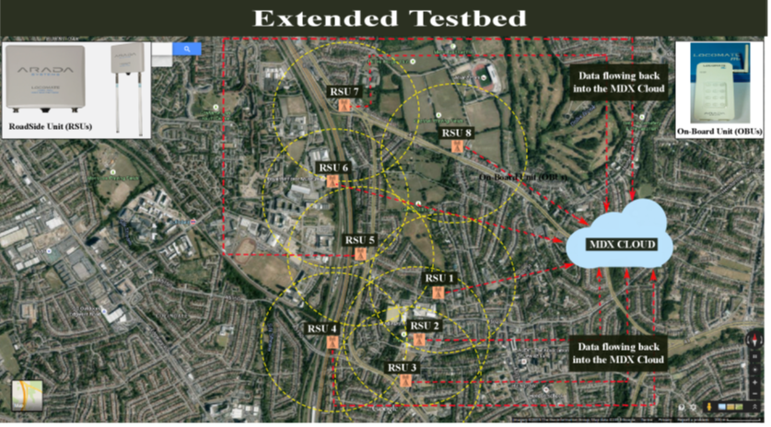
Middlesex University – A41 Testbed

Slide 14

Middlesex Connected Vehicle Research: Guaranteeing Seamless Communication
Interference Region
Time to Handover (T_{EH})
RSU 1
RSU 2
Time before Handover
Data Exchange
Detection Range

Slide 15
Guidance and research
Need to capture the evidence
Monitoring and common evaluation framework
Create a research programme that informs
  Urban C-ITS
  SPAT MAP
  UTMC/SCOOT development
  Connected Parking

Slide 16
CAPITAL programme
Will create a training programme for ITS/C-ITS practitioners - which will:
create a platform of practitioners
assess the capacity needs and knowledge gaps
implement online and via physical presence training courses
train practitioners to design viable business models and business cases for investment
develop a (Cooperative) ITS deployment transferability handbook.

Slide 17
Summary
What is the DfT approach to smarter traffic management?
  Deployment – “to learn by doing”
  Learning from others
  Invest different levels of deployment
  Creating partnerships
  Promoting dissemination
  C-ITS Deployment Board/Deployment Day
  Research projects

